Slide 1
Collecting Related Works
Search “rust fuzzing” and “fuzz rust” in google scholar
Review the 100 most relevant results for each keyword
Collect 2 papers on fuzzing Rust programs
Collect 9 papers on analyzing Rust safety bugs
using static analysis, dynamic analysis other than fuzzing, or manual analysis

Slide 2
2 papers on fuzzing Rust programs
Jianfeng Jiang, Hui Xu, and Yangfan Zhou. "RULF: Rust library fuzzing via API dependency graph traversal." ASE 2021.
George Mocanu, Costin Carabaş, and Nicolae Ţăpuş. "Fuzz testing in AWS Firecracker hypervisor." ISPDC 2021.

Slide 3
9 papers on analyzing Rust safety bugs
Zhuohua Li, Jincheng Wang, Mingshen Sun, and John Chi Shing Lui. "MirChecker: Detecting Bugs in Rust Programs via Static Analysis." CCS 2021.
Yechan Bae, Youngsuk Kim, Ammar Askar, Jungwon Lim, and Taesoo Kim. "Rudra: Finding Memory Safety Bugs in Rust at the Ecosystem Scale." SOSP 2021.
Marcus Lindner, Jorge Aparicius, and Per Lindgren. "No panic! Verification of Rust programs by symbolic execution." INDIN 2018.
Michalis Papaevripides and Elias Athanasopoulos. "Exploiting mixed binaries." TOPS 2021.
Baojian Hua, Wanrong Ouyang, Chengman Jiang, Qiliang Fan, Zhizhong Pan. "Rupair: Towards Automatic Buffer Overflow Detection and Rectification for Rust." ACSAC 2021.
Mohan Cui, Chengjun Chen, Hui Xu, Yangfan Zhou. "SafeDrop: Detecting memory deallocation bugs of rust programs via static data-flow analysis." arXiv 2021.
Boqin Qin, Yilun Chen, Zeming Yu, Linhai Song, and Yiying Zhang. "Understanding memory and thread safety practices and issues in real-world Rust programs." PLDI 2020.
Hui Xu, Zhuangbin Chen, Mingshen Sun, Yangfan Zhou, Michael R. Lyu. "Memory-Safety Challenge Considered Solved? An In-Depth Study with All Rust CVEs." TOSEM 2021.
Ana Nora Evans, Bradford Campbell, and Mary Lou Soffa. "Is Rust used safely by software developers?." ICSE 2020.

Slide 4
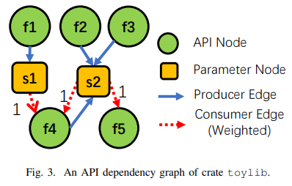
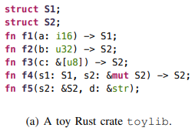
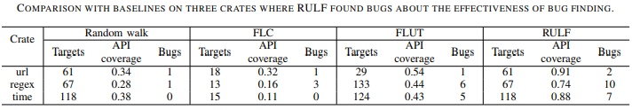
RULF: Rust Library Fuzzing via API Dependency Graph Traversal, ASE 2021
Generate fuzz targets for a Rust library automatically
Generate an API sequence as a fuzz target
By exploring API dependency graph of the target library
Using breath-first search and backward search from uncovered APIs
Evaluation

Slide 5
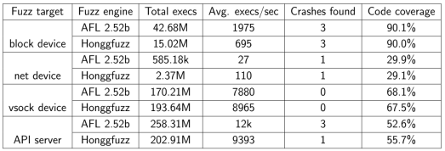
Fuzz Testing in AWS Firecracker Hypervisor, ISPDC 2021
Integrating fuzz testing environment into the Firecracker (i.e., AWS hypervisor written in Rust) development cycle
Design considerations
Fuzzing each interface of Firecracker with a small fuzz target instead of a large fuzz target with a guest OS image
Through five emulated devices, network, block, vsock, serial console, and keyboard controller
Dictionary-based mutation to generate valid inputs
Use AFL as the main fuzzer to utilize parallel fuzzing
it allows multiple fuzzer instances with different mutation strategies
Evaluation

Slide 6
MirChecker: Detecting Bugs in Rust Programs via Static Analysis, CCS 2021
Static analysis for detecting runtime panics and lifetime corruption in Rust programs
Key concepts of the static analysis
Use panics and pre-defined list of unsafe functions as error locations
Use abstract interpretation for unbounded data-flow analysis
Use fixed-point exploration of the control-flow graph
Evaluation
Found all the known issues in the 10 artificial code snippets
Found 33 previously unknown bugs including 16 memory-safety issues from 12 Rust crates
No comparison with another technique

Slide 7
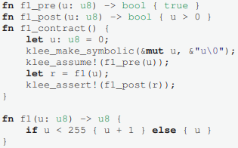
No panic! Verification of Rust Programs by Symbolic Execution, INDIN 2018
Apply symbolic execution to a Rust program with contract-based verification
KLEE as the symbolic executor
An example contract for a function f1
No evaluation

Slide 8
Exploiting Mixed Binaries, TOPS 2021
Check whether vulnerabilities in a hardened mixed binary (combination of unsafe C/C++ codes with safe Rust code) are exploitable by bypassing the hardened part or not
Static and dynamic analysis for the check
Collecting functions with indirect branches by using static analysis
Dynamically check whether the indirect branches can be overwritable or not
Evaluation on Mozila Firefox
From the 174,790 functions in Firefox, found 2,755 interesting indirect branches
By dynamic analysis, 18 indirect branches are identified as the bypassable C function call

Slide 9
Rupair: Towards Automatic Buffer Overflow Detection and Rectification for Rust, ACSAC 2021
Automated buffer-overflow detection and repair (rectification) suggestion
Identify buffer-overflow vulnerability using a data-flow analysis
Based on def-use analysis
Confirm the buffer-overflow using constraint solving with counterexample
Suggest rectification of the buffer-overflow automatically using the counterexample
Evaluation
Found buffer-overflows in 9 CVE/programs among 10 CVE/programs of which address sanitizer cannot found bugs

Slide 10
SafeDrop: Detecting Memory Deallocation Bugs of Rust Programs via Static Data-flow Analysis, arXiv 2021
Detecting memory deallocation bugs (e.g., use-after-free, dangling pointer, double free) using a static path-sensitive data-flow analysis
The static analysis
Avoid path explosion by using meet-over-path method and modified Tarjan algorithm (eliminate redundant paths)
Analyze the safety of drop statements for each extracted path
Recursive analysis following function calls
Evaluation
Achieve 100% recall for 8 known CVEs (with reasonable FP)
Among 8 real-world Rust crates, no FP for 6 crates and no more than 2 FP for a crate

Slide 11
Understanding Memory and Thread Safety Practices and Issues in Real-world Rust Programs, PLDI 2020
Empirical study on real-world Rust programs (850 unsafe code usages, 70 mem-safety issues, and 100 thread-safety issues)
Two new static bug detector
For detecting memory bugs
Maintain state of each variable (dead or alive) by monitoring MIR calls
Conduct “points-to” analysis to identify whether a dereferenced pointer/reference is dead or alive
Found four previously unknown bugs
For detecting concurrency bugs
Check lifetime of each lock by identifying call sites of lock() and the implicit release sites of them
Found six previously unknown double-lock bugs

Slide 12
Memory-Safety Challenge Considered Solved? An In-Depth Study with All Rust CVEs, TOSEM 2021
Survey 186 bug reports of real-world Rust crates
Found three typical categories of mem-safety bugs
Automatic mem reclaim, unsound function, and unsound generic or trait
Best practice for code suggestion
Proper generic bound declaration (similar to the propagating Send/Sync in generic types bug defined in the RUDRA paper)
Avoiding bad drop at cleanup (similar to the panic safety bug defined in the RUDRA paper)
Proper unsafe declaration

Slide 13
Is Rust Used Safely by Software Developers?
Ana Nora Evans, Bradford Campbell, and Mary Lou Soffa.
University of Virginia
ICSE 2020

Slide 14
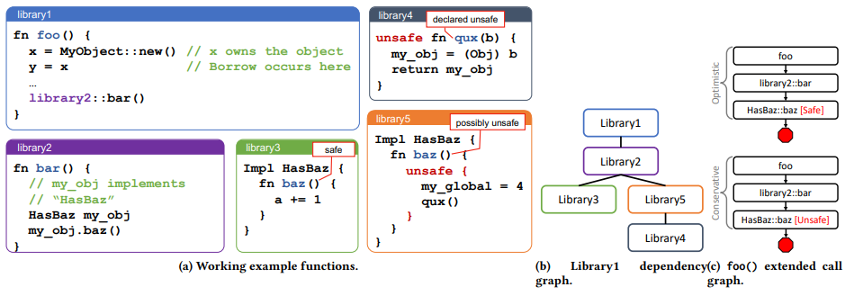
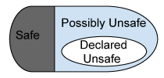
How Much Unsafe Codes are Used in Rust Programs?
Not only declared unsafe codes but also possibly unsafe codes
Functions in libraries
Dependency graph of the libraries
Function annotation taxanomy

Slide 15
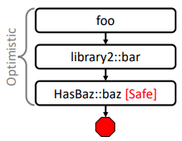
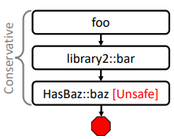
Extended Function Call Graph Analysis
To identify safe, declared unsafe, and possibly unsafe functions
two versions of call graphs: optimistic and conservative by considering polymorphism
Functions in libraries

Slide 16
Research Questions
How much Rust codes are unsafe?
RQ1: How much declared unsafe?
RQ2: How much possibly unsafe?
How developers use unsafe codes?
RQ3: What Unsafe Rust operations are used?
RQ4: What type of unsafe functions are called?
RQ5: Does the use of Unsafe Rust change over time?
RQ6: Why do Rust developers use unsafe?

Slide 17
Data Selection
13,096 crates from crates.io
Excluding crates that are not compiled (30% of the total registered crates)
Most Downloaded: a subset of 462 top downloaded crates from crates.io
Servo (approximately 50 crates)
As “higher quality” crates

Slide 18
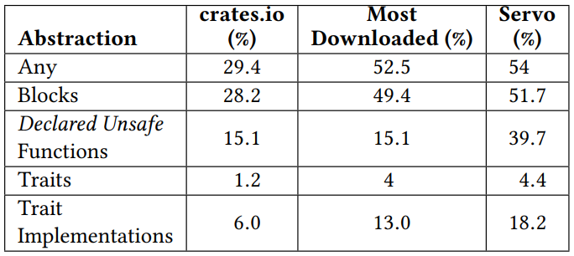
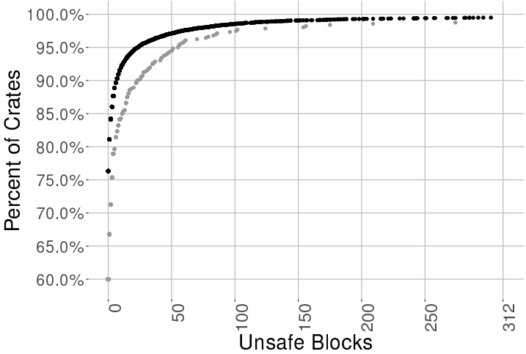
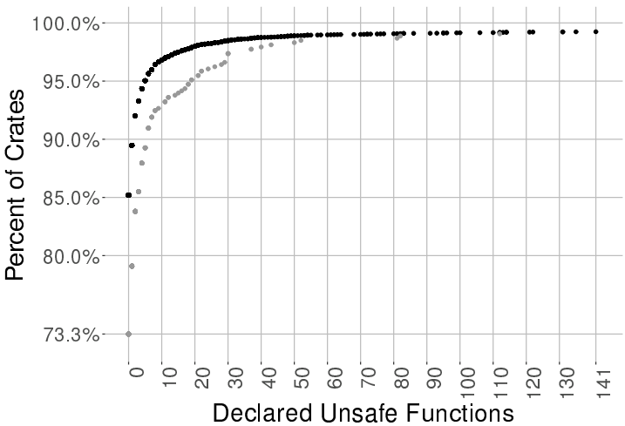
RQ1: How much declared unsafe?
Count the number of declared unsafe blocks, functions, traits, and traits implementations in each crates
crates.io
Most Down.
Percentage of Rust crates with Unsafe Rust based on abstraction type
Cumulative distribution of unsafe codes

Slide 19
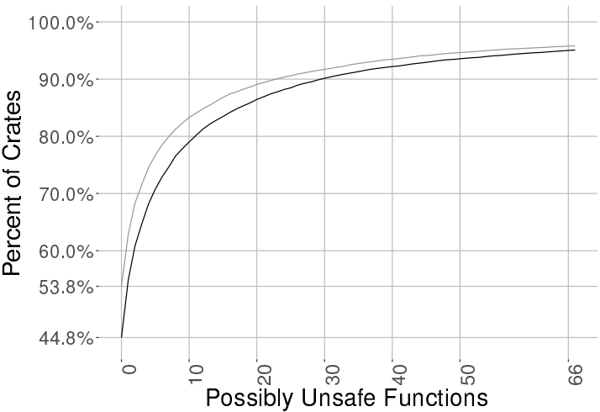
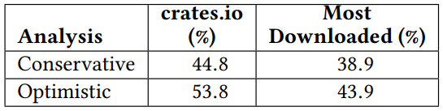
RQ2: How much possibly unsafe?
Less than 1/3 crates directly use unsafe.
Over half of crates use unsafe codes somewhere in the aggregate code
optimistic
conservative
Percentage of crates with only safe functions
Possibly unsafe functions distribution of all crates

Slide 20
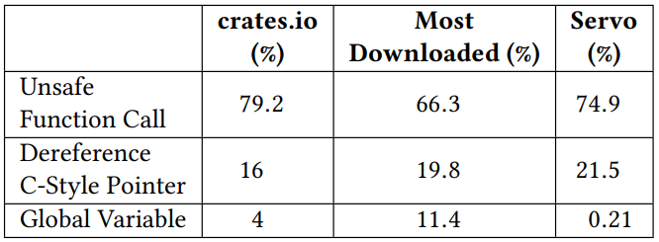
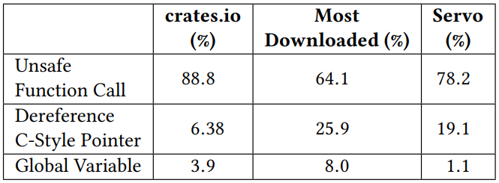
RQ3: What Unsafe Rust operations are used?
Distribution of unsafe operations in a data set
Results of crates that have more than 1% of unsafe operations
Unsafe operations in unsafe blocks
Unsafe operations in unsafe functions

Slide 21
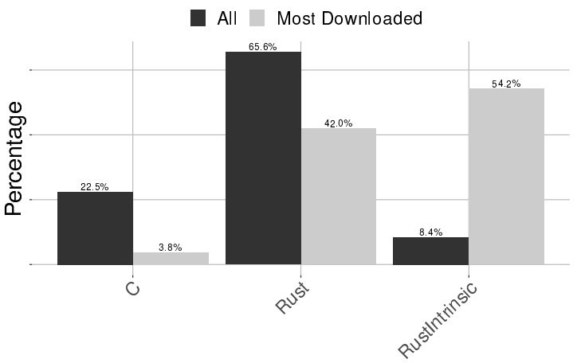
RQ4: What type of unsafe functions are called?
Three types of unsafe functions
extern C functions, declared Rust functions, and Rust Intrinsic

Slide 22
Discussion
No analysis about whether the unsafe codes are “actually” unsafe
Higher portion of (possibly) unsafe rust does not mean lower safety.
Using unsafe itself does not induce a crash.

Slide 23
Rudra: Finding Memory Safety Bugs in Rust at the Ecosystem Scale.
Yechan Bae, Youngsuk Kim, Ammar Askar,
Jungwon Lim, and Taesoo Kim
Georgia Institute of Technology
SOSP 2021

Slide 24
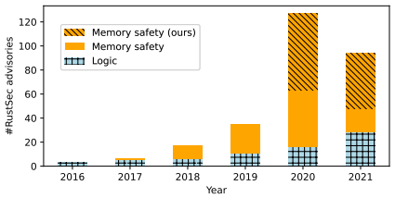
Does Unsafe Rust Codes Actually Induce Memory Safety Bugs?
Find three important bug patterns in Unsafe Rust
Propose two scalable static analysis algorithms (as RUDRA) to find the patterns
Detect 264 new memory safety bugs in Rust ecosystem
Which are more than half (51.6%) of the known memory bugs in RustSec since 2016
Memory safety bugs that RUDRA found

Slide 25
Three Mem Safety Bug Patterns
Panic safety bug
Higher-order safety invariant bug
Propagating Send/Sync in generic types bug
Which are hard to reasoning by traditional testing due to
Compiler generated codes (i.e., panic safety bug)
Limitation of Rust type system (i.e., higher-order safety invariant bug)
Manual trait implementation (i.e., propagating Send/Sync in generic types bug)

